Slide 1
CIND 820 Project Report Name: Nelly Grillo Student number: 501144764 Supervisor: Ceni Babaoglu, Ph.D. Date: December 5th, 2022
Level of Satisfaction of airline customers using Machine Learning Algorithms

Slide 2
Problem Statement
Determine the most important factors that impact the airline customer satisfaction
Determine if the customer type, loyal and first-time customer, have an effect on airline costumer satisfaction
Determine if customer class, Business or Economy, play a key role in airline costumer satisfaction
Predict customer satisfaction using Machine learning (ML) algorithms
Determine which ML algorithm is the most accurate

Slide 3
Dataset and Data Description
Dataset from Kaggle contains: 130, 000 survey entries, 24 feature columns
Variables: 19 categorical variables and 4 numerical variables
Target variable: “Satisfaction”: satisfied, neutral/dissatisfied
 | Type | Mean | Std | Min | Max
Gender | Categorical: Nominal
Customer Type | Categorical: Nominal
Type of Travel | Categorical: Nominal
Class | Categorical: Nominal
Inflight Wi-Fi service | Categorical: Ordinal
Departure/Arrival time convenient | Categorical: Ordinal
Ease of Online booking | Categorical: Ordinal
Gate location | Categorical: Ordinal
Food and drink | Categorical: Ordinal
Online boarding | Categorical: Ordinal
Seat comfort | Categorical: Ordinal
Inflight entertainment | Categorical: Ordinal
On-board service | Categorical: Ordinal
Leg room service | Categorical: Ordinal
Baggage handling | Categorical: Ordinal
Check-in service | Categorical: Ordinal
Inflight service | Categorical: Ordinal
Cleanliness | Categorical: Ordinal
Satisfaction | Categorical: Ordinal
Age | Numerical | 39.380466 | 15.113125 | 7.0 | 85.0
Flight Distance | Numerical | 1189.325202 | 997.297235 | 31.0 | 4983.0
Departure Delay in Minutes | Numerical | 14.747939 | 38.116737 | 0.0 | 1592.0
Arrival Delay in Minutes | Numerical | 15.178678 | 38.698682 | 0.0 | 1584.0

Slide 4
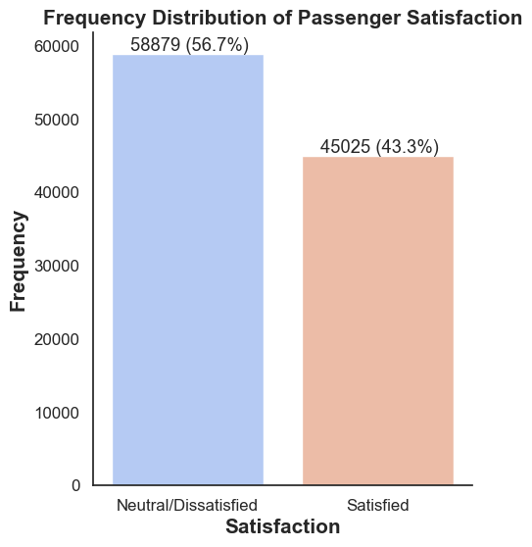
Exploratory Data Analysis
Data Preparation
Target variable
Checking for Imbalance in the Target variable
Notes:
The above plot shows that the data in the target variable is relatively evenly distributed between the Neutral/Dissatisfied and the Satisfied passengers (57% and 43% respectively). It can be interpreted as a balanced data because there is no significant difference. For this reason, the dataset will not need any special treatment/resampling.

Slide 5
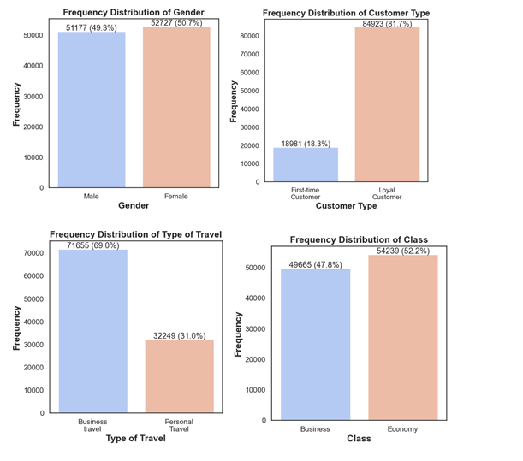
Frequency distribution of categorical variables: Gender, Customer Type, Type of Travel and Class
Notes:
There is no significant difference in the Gender distribution: males (49%) and females (51%).
The difference between First-time Customers and Loyal Customers is significant, with a great number of Loyal Customers (82%).
The type of travel that is predominant is the Business customers (69%), and the airline might focus more on this group.
This plot shows that the Economy class is the predominant after combining the Eco and Eco Plus classes, but the difference is small. Although, the Business Type of Travel was higher, there were lower customers in Business Class (48%).

Slide 6
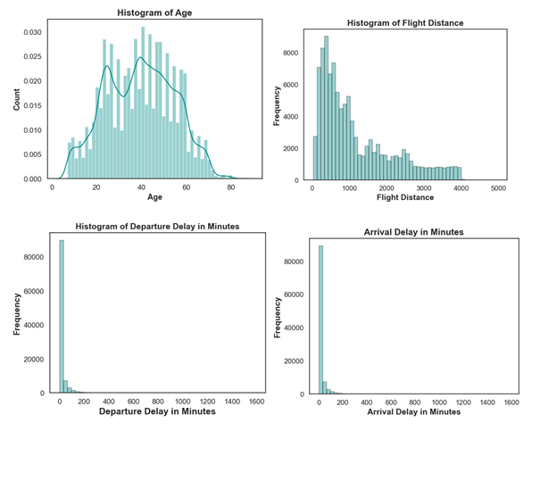
Histogram of Age, Flight Distance, Departure and Arrival Delay in Minutes
Notes:
The Age distribution seems to be slightly right-skewed.
This right-skewed histogram of Flight Distance shows that most flights possibly are domestics with a flight distance under 1000 miles.
The histogram of Departure and Arrival Delay in minutes shows the possible presence of outliers which will be assessed in the following steps.

Slide 7
Data Cleaning
Missing Data - NaN Values
Arrival Delay in Minutes variable: replaced with the average values
train dataset: 310 missing values
test dataset: 83 missing values
No Duplicate Values

Slide 8
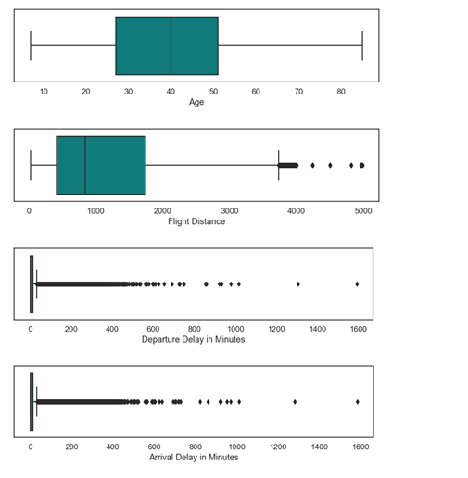
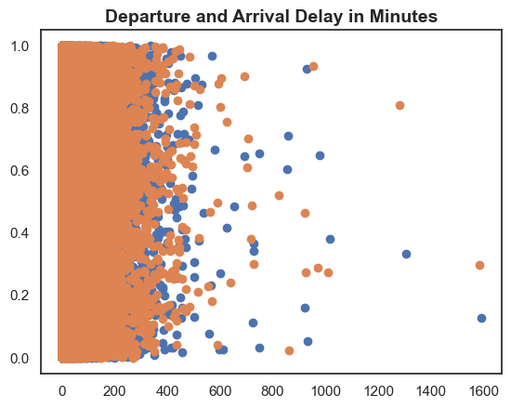
Outliers
Notes:
The above boxplots and the descriptive statistics table shows that there are large values for the Departure Delay in Minutes and Arrival Delay in Minutes: 1592 and 1584 respectively.
Those extreme few values are not errors, and they seem to be a natural part for the dataset. For this reason, the outliers will not be removed from the dataset.

Slide 9
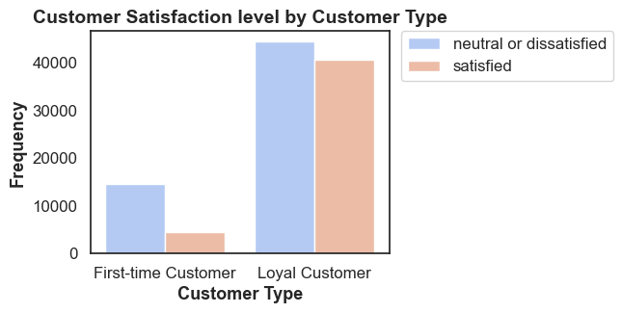
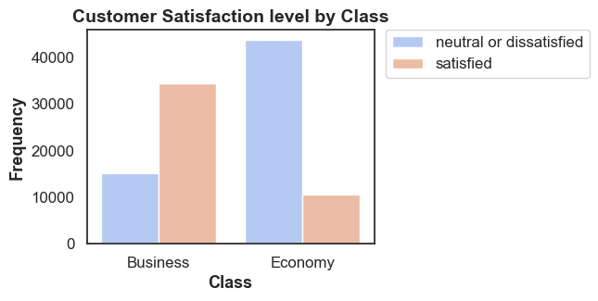
Bivariate Analysis
Customer Satisfaction level by Customer type
Customer Satisfaction level by
Class
Notes:
Customer Type:
This plot shows that among the Loyal customers, there is a similar ratio between neutral/dissatisfied (43%) and satisfied (39%) airline customers.
On the other hand, for First-time customers, there is a lower ratio of satisfaction level. This could be for the higher expectation that normally first-time customers have.
Overall, Loyal customers (39%) has a higher satisfaction level than the First-time customers (4%).
Class:
This plot shows the predominance of customers satisfied in the Business class (33%) comparing with the large number of neutral/dissatisfied customers in the Economy class (42%).

Slide 10
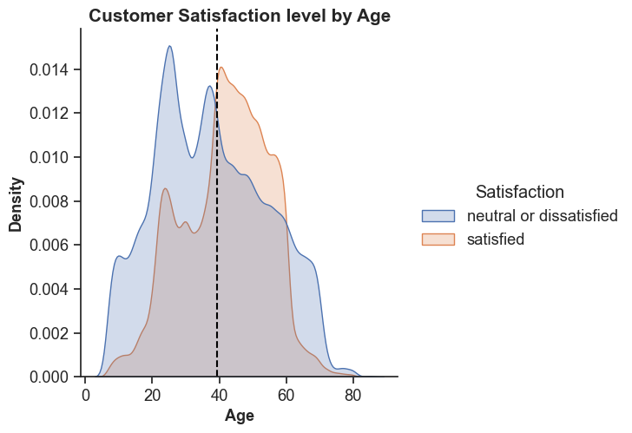
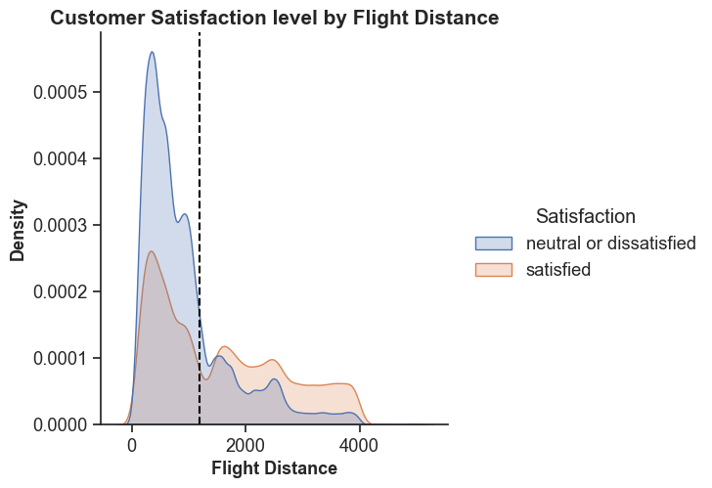
Customer Satisfaction level by
Age
Customer Satisfaction level by
Flight Distance
Notes:
Age:
This density plot shows that in the age range between 40 and 60, the number of satisfied customers is higher than the neutral/dissatisfied customers.
Flight Distance:
This plot shows that the level of customer dissatisfaction is high in customers that travelled approximately less than 1100 miles (approx. mean). On the other hand, there is a significant level of customer satisfaction in long distance flight (more than approx. 1100 miles).

Slide 11
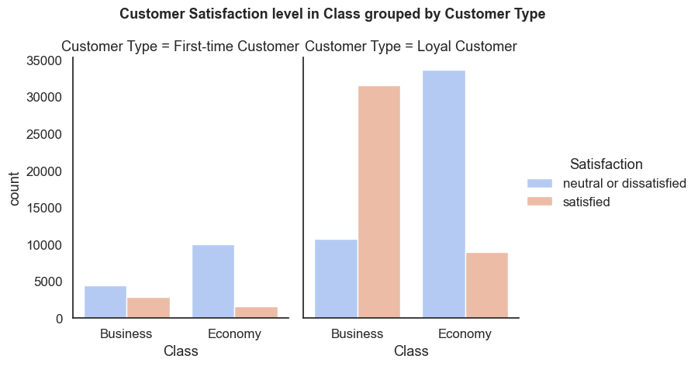
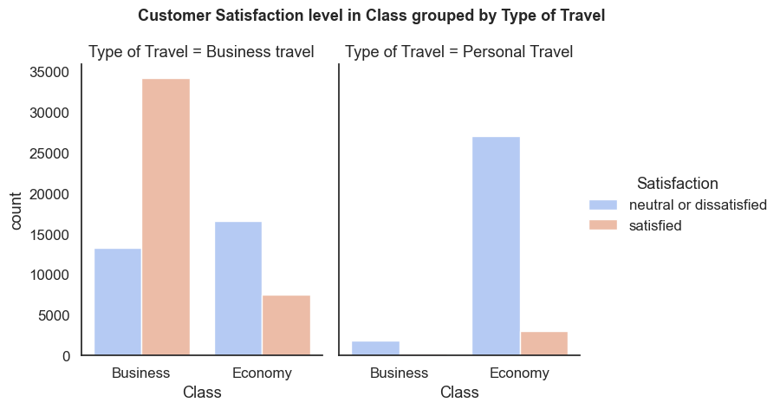
Customer Satisfaction level in relation to Class by Consumer Type
Customer Satisfaction level in relation to Class by Type of Travel
Notes:
Loyal Customers, who travel in Business Class, are likely more satisfied than the First-time customers who go in Business Class.
Customers with Business Type of Travel, and who travel in Business Class, are likely more satisfied than the customers with Personal Type of Travel who go in Business Class.

Slide 12
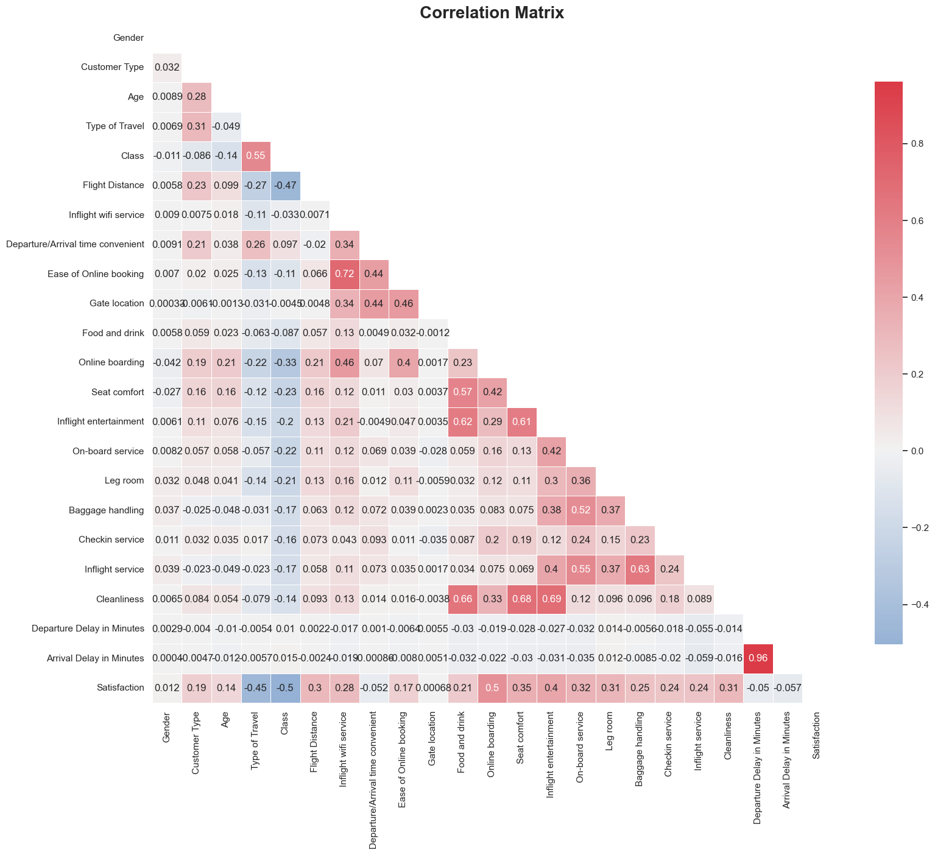
Feature Selection
Label encoding in train and
test dataset
Correlation matrix heatmap
Weak correlation
Negative correlation :
class feature (0.5038), and
Positive correlation:
Online boarding feature (0.5036).
Notes:
This correlation matrix shows that the Satisfaction target feature has some weak correlation with all other features, having a negative correlation with the Class feature (0.5038), and
A positive correlation with the Online boarding feature (0.5036). Furthermore, there is no significant correlation between the Satisfaction target with the features: Gender (0.012) and Gate location (0.00).
Moreover, it shows the following positive correlation between features:
Cleanliness and Inflight entertainment (0.69),
Cleanliness and Seat Comfort (0.68),
Ease of Online booking and Inflight Wi-Fi service (0.72),
Departure and Arrival Delay in Minutes (0.96).

Slide 13
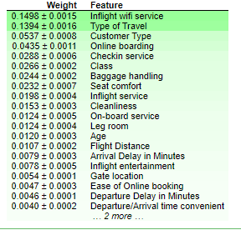
Feature Importance using Permutation Importance
Notes:
The most relevant features using the Permutation importance are: Inflight wifi service, Type of Travel, Customer Type, Online boarding, Check in service, Class, Baggage handling, Seat comfort, Inflight service, Cleanliness, On-board service, Leg room.
After careful consideration, the features to be dropped are Gender, Age, Departure/Arrival time convenient, Ease of Online booking, Gate location, Food and drink, Departure Delay in Minutes, and Arrival Delay in Minutes.

Slide 14
Modelling
Stratified sampling of 10-fold cross-validation
Machine learning algorithms
Logistic Regression, Gaussian Naïve Bayes, K-Nearest Neighbors, Decision Tree, Random Forest, and XGBoost.
Performance evaluation metric
Accuracy, F1 score, ROC, AUC

Slide 15
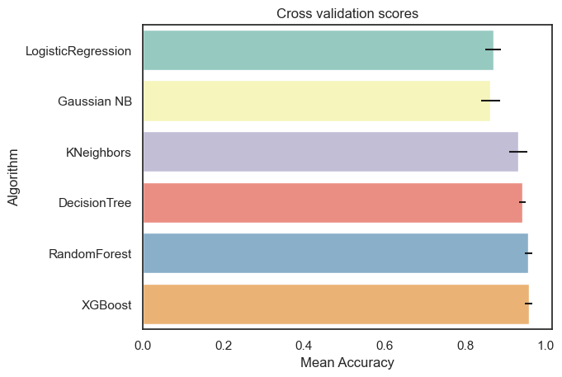
Model performance and Evaluation
Results on performance prediction after feature selection

Slide 16
Model performance and Evaluation
Results on performance prediction after feature selection
Machine Learning | Accuracy | Precision | Recall | F1 score | AUC | Time taken
Logistic Regression | 86.84% | 86.47% | 83.02% | 84.71% | 0.92 | 0.761
Gaussian Naïve Bayes | 86.19% | 86.91% | 80.71% | 83.69% | 0.92 | 0.063
K-Nearest Neighbor | 93.07% | 97.07% | 86.82% | 91.67% | 0.98 | 9.361
Decision Tree | 93.76% | 93.79% | 91.85% | 92.81% | 0.98 | 0.091
Random Forest | 96.00% | 96.86% | 93.94% | 95.37% | 0.99 | 6.270
Extreme Gradient Boosting (XGBoost) | 95.49% | 95.69% | 93.97% | 94.83% | 0.99 | 36.272
Notes:
This project compared six machine learning algorithms, as Random Forest demonstrate the highest accuracy as 96% and highest F1 score as 95.37%, to predict airline customer satisfaction. Extreme Gradient Boosting (XGBoost) follows it with accuracy 95.49% and F1 score 94.83%.

Slide 17
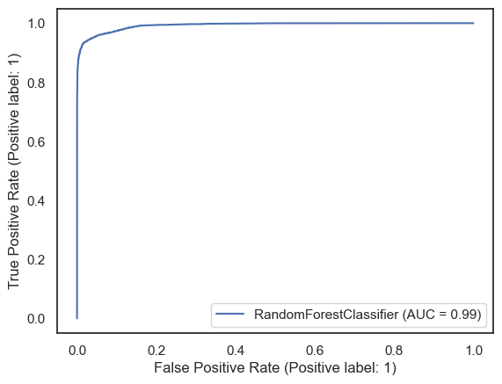
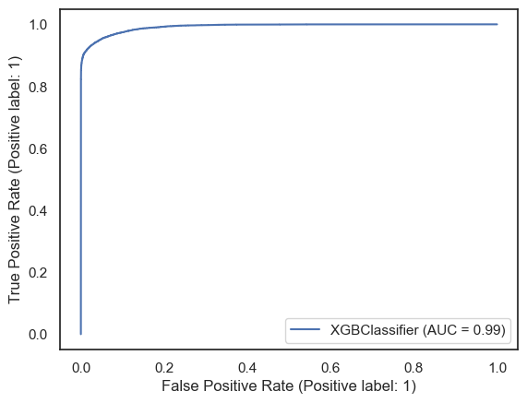
Model performance and Evaluation
Results on ROC after feature selection
Notes:
The graph shows the ROC curve result which illustrates Random Forest and Extreme Gradient Boosting (XGBoost) as the fittest classifiers with a AUC score = 0.99. Both algorithms are the fittest classifier for predicting airline customer satisfaction.

Slide 18
Conclusions
Services to improve: Inflight Wi-Fi service, Type of Travel, Customer Type, Online boarding, Check in service, Class, Baggage handling, Seat comfort, Inflight service, Cleanliness, On-board service, Leg room, Flight Distance, and Inflight entertainment.
Customer Type and customer class have an impact on the airline customer satisfaction. Airlines should provide quality service and implement new strategies.
Random Forest is the fittest machine learning algorithm: accuracy 96% and F1 score 95.37%

Slide 19
Work limitations
Other major factors that influence the airline customer satisfaction that are not investigated in this project. IATA list over 70 factors that affect the airline travel satisfaction.

